Slide 1








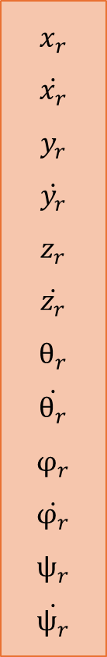




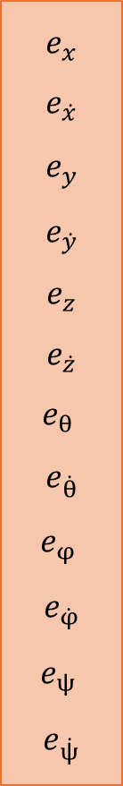



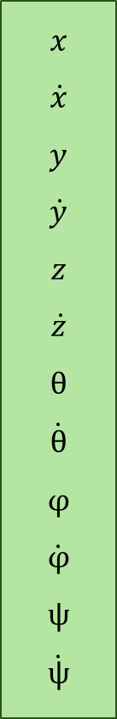


Lệnh điều khiển từ controller
$$\dot{x}$$
$$φ_{r}$$
$$\dot{x}$$
$$\dot{y}$$
$$\dot{z}$$
$$\dot{ψ}$$
dt
$$x_{r}$$
$$\dot{x_{r}}$$
$$y_{r}$$
$$\dot{y_{r}}$$
$$z_{r}$$
$$\dot{z_{r}}$$
$$θ_{r}$$
$$\dot{θ_{r}}$$
$$φ_{r}$$
$$\dot{φ_{r}}$$
$$ψ_{r}$$
$$\dot{ψ_{r}}$$
$$x$$
$$\dot{x}$$
$$y$$
$$\dot{y}$$
$$z$$
$$\dot{z}$$
$$θ$$
$$\dot{θ}$$
$$φ$$
$$\dot{φ}$$
$$ψ$$
$$\dot{ψ}$$
$$e_{x}$$
$$e_{\dot{x}}$$
$$e_{y}$$
$$e_{\dot{y}}$$
$$e_{z}$$
$$e_{\dot{z}}$$
$$e_{θ }$$
$$e_{\dot{θ}}$$
$$e_{φ }$$
$$e_{\dot{φ}}$$
$$e_{ψ }$$
$$e_{\dot{ψ}}$$
P_x
PI_x
$$u_{1}$$
Mixer
$$u_{2}$$
$$θ_{r}$$
$$u_{3}$$
dt
$$\dot{y}$$
$$u_{4}$$
P_y
PI_y
Tín hiệu điều khiển động cơ
dt
$$\dot{z}$$
P_z
PI_z
DRONE
-
=
$$\dot{θ_{r}}$$
P_θ
PI_θ
$$\dot{φ_{r}}$$
P_$φ$
PI_$φ$
dt
$$\dot{ψ}$$
P_$ψ$
PI_$ψ$
Cảm biến đo 12 trạng thái

